Slide 1
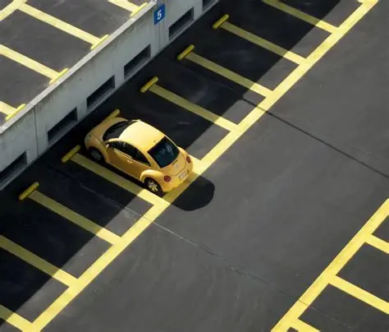

PARK HERE
Parking space utilization mobile application
PROJECT GUIDE
Dr.A.Thirumurthi Raja
Assistant Professor,
SRMIST-DDE,
HEAD OF DEPARTMENT
Dr.A.Thirumurthi Raja
Program Coordinator
Department of Computer Applications,
Directorate of Distance Education (DDE)
SRMIST

Slide 2
Abstract
In urban areas, finding available parking spaces is a growing challenge due to limited infrastructure and increasing vehicle density. ParkHere is a platform-independent application that enables peer-to-peer sharing of parking spaces, allowing users to post, view, and occupy available spots in real time. The system uses Supabase for backend services, ensuring seamless data synchronization and secure authentication. With a live map interface, users can easily locate nearby parking spots and view their occupancy status. This project aims to optimize space utilization, reduce time spent searching for parking, and promote smart city mobility solutions.

Slide 3
Introduction
Urban areas face a critical shortage of parking spaces.
Many private parking spots remain unused when owners are away.
ParkHere provides a peer-to-peer solution connecting parking owners with drivers seeking parking.
The app promotes space optimization, convenience, and smart urban mobility.

Slide 4
Problem Statement
Difficulty finding available parking spots in crowded cities.
Wasted time and fuel while searching.
Lack of real-time availability updates.
No unified platform for private users to list or rent parking spaces.

Slide 5
Existing System
Manual or app-based public parking systems.
Limited visibility of private parking spots.
No peer-to-peer sharing or live occupancy tracking.
Users face uncertainty about availability and pricing.

Slide 6
Proposed System
Live background map showing nearby available spaces.
Users can post parking availability instantly.
Occupied spaces are shown with time duration
Planned integration of payment and verification systems.

Slide 7
ParkHere successfully demonstrates a smart and scalable approach for urban parking management using a peer-to-peer model.
Conclusion
ParkHere successfully demonstrates a smart and scalable approach for urban parking management using a peer-to-peer model.
Future Enhancements:
Add online payment and wallet systems.
Integrate user verification (KYC).
Implement parking history and analytics dashboard.
Develop an AI-based availability predictor.

